Slide 1
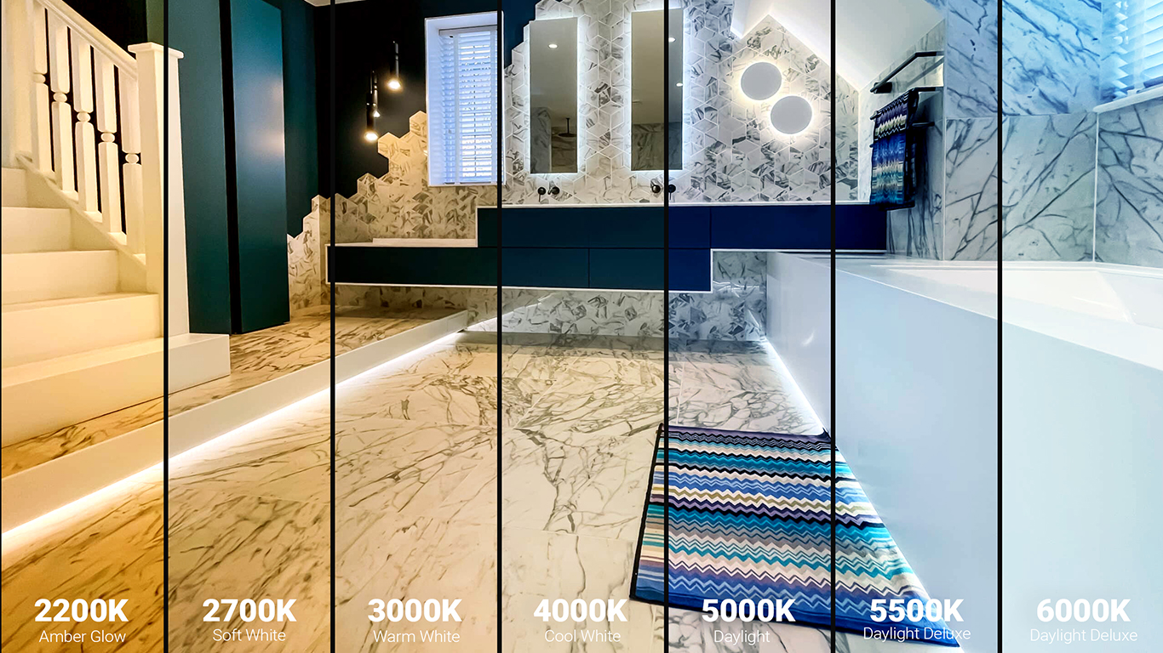
CCT VS CRI
Understanding Color Temperature (CCT) & Color Rendering Index (CRI)

Slide 2
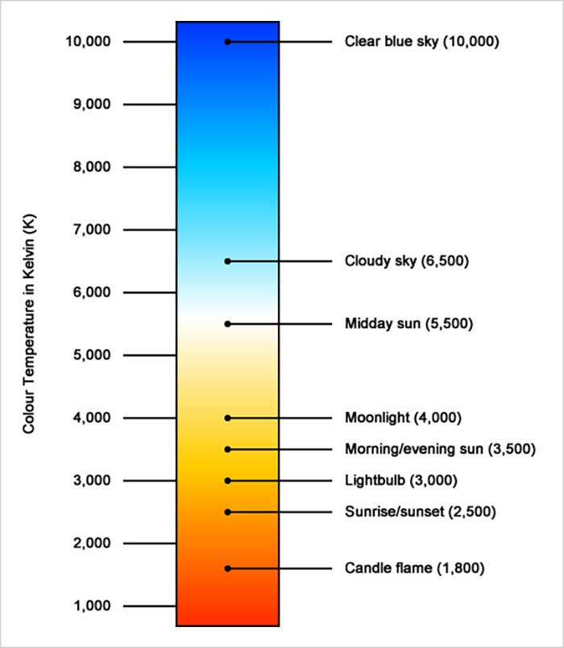
CT vs CCT
CT (Color Temperature): Raw theoretical value
CCT: Human-perceived equivalent color of white light source
Used more in practical lighting specs
Term | CT – Color Temperature | CCT – Correlated Color Temperature
Meaning | Theoretical color temperature of blackbody radiation | Perceived color temperature of real-world light sources
Source | Ideal blackbody radiator (physics-based) | LEDs, fluorescents, etc.
Used In | Physics calculations, simulations | Lighting design and product specifications

Slide 3
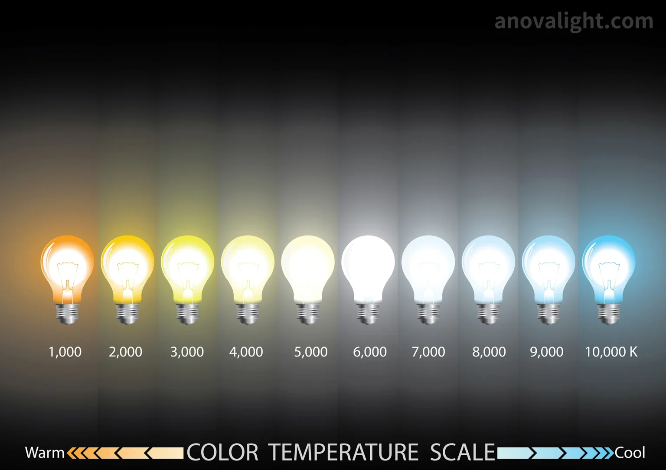
What is CCT?
CCT = Correlated Color Temperature
Measured in Kelvin (K)
Describes the appearance of white light:
2700K = Warm (yellowish)
4000K = Neutral white
6500K = Cool (bluish white)

Slide 4
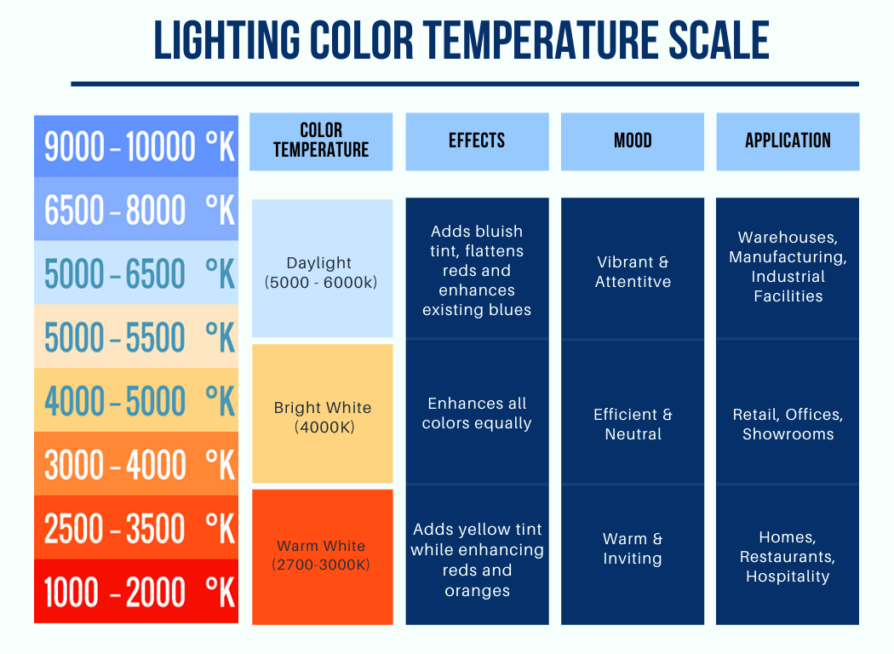
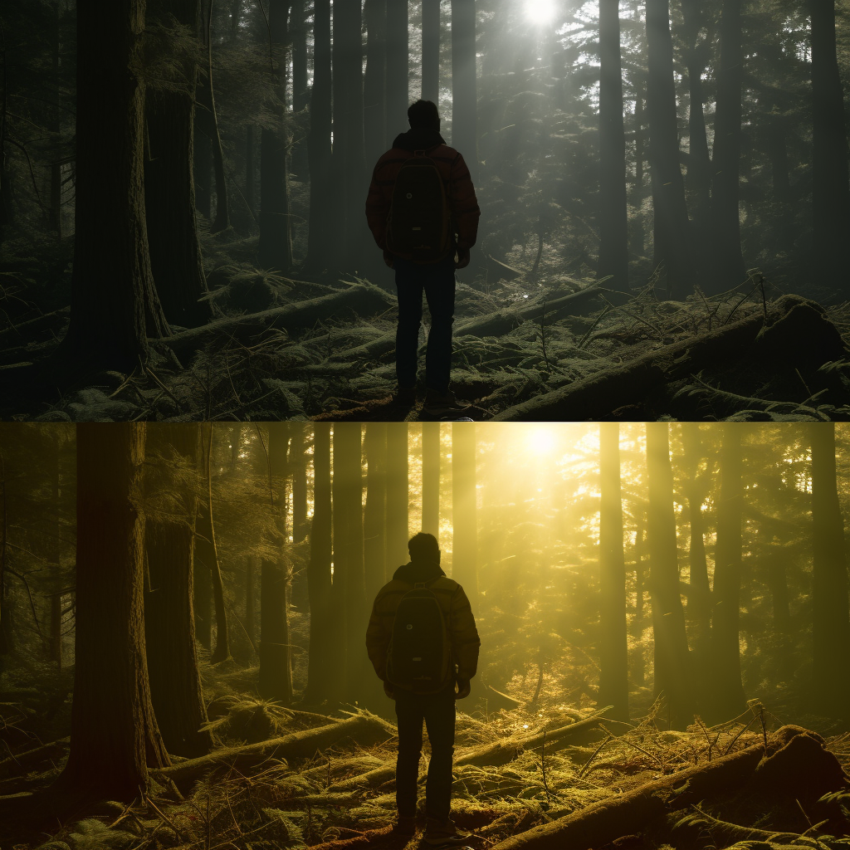
What is CCT?
Same person Same Place But: Different CCT

Slide 5

CCT Examples

Slide 6
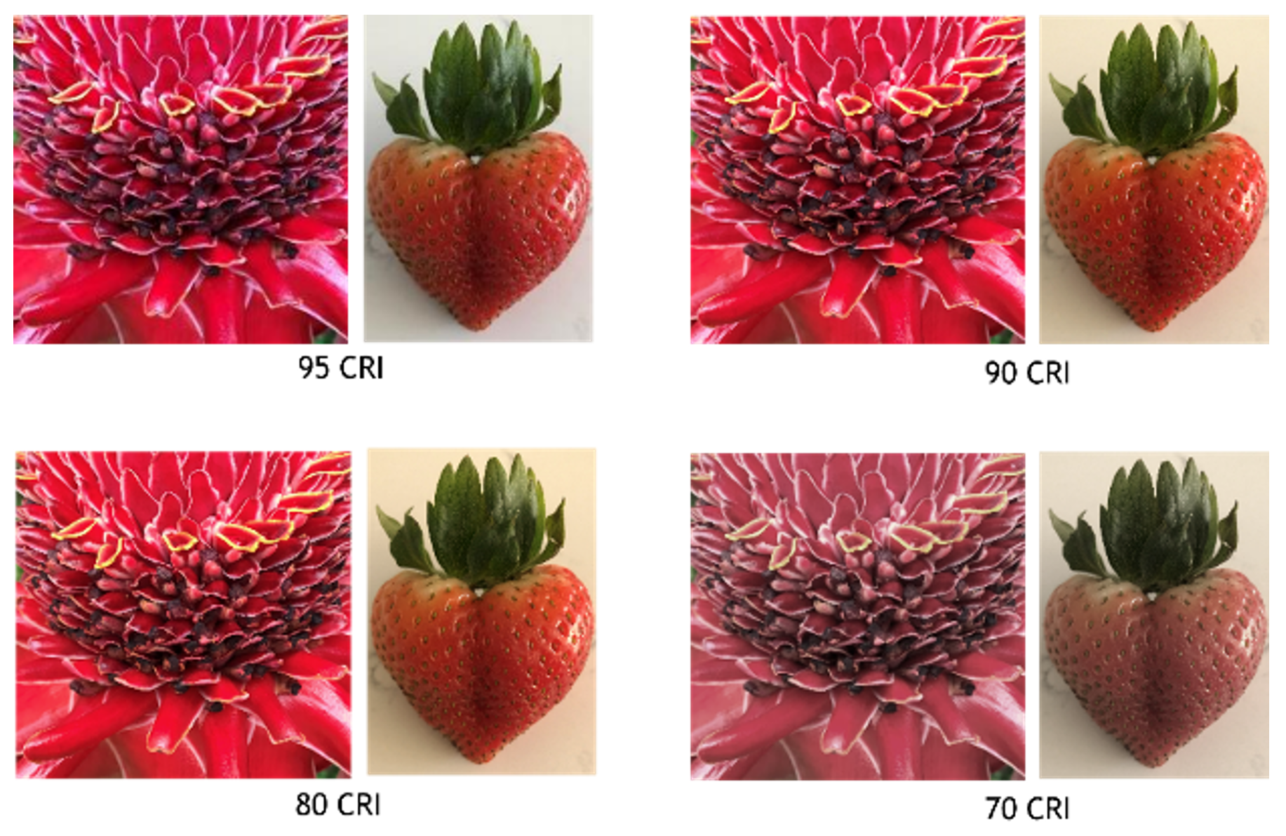
What is CRI?
CRI = Color Rendering Index
Scale: 0 to 100
Measures light's ability to reveal accurate colors
High CRI (>90): True, vibrant colors

Slide 7
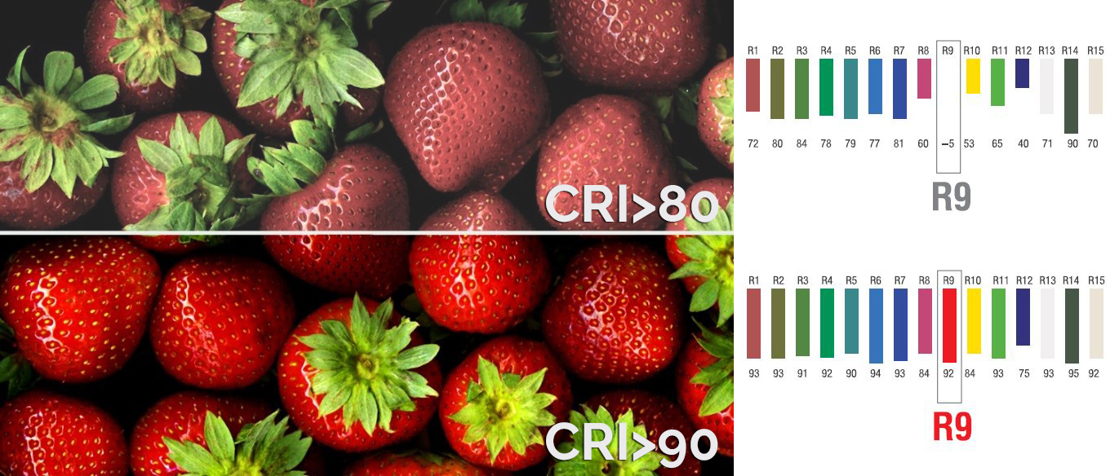
CRI Examples

Slide 8
CCT vs CRI Comparison
Feature | CCT | CRI
Definition | Color tone of white light | Accuracy of color rendering
Unit | Kelvin (K) | Index (0–100)
Affects | Mood, appearance | Visual clarity, color fidelity

Slide 9
Choosing Right Values
Choosing the Right CCT:-
Choosing the Right CRI
Warm white (Relaxation) : 2700K–3000K
Neutral white (Focus) : 3500K–4100K
Cool white (Alertness) : 5000K–6500K
CRI > 90: Ideal for photography, fashion
CRI 80–90: Good for general use
CRI < 80: Risk of color distortion

Slide 10
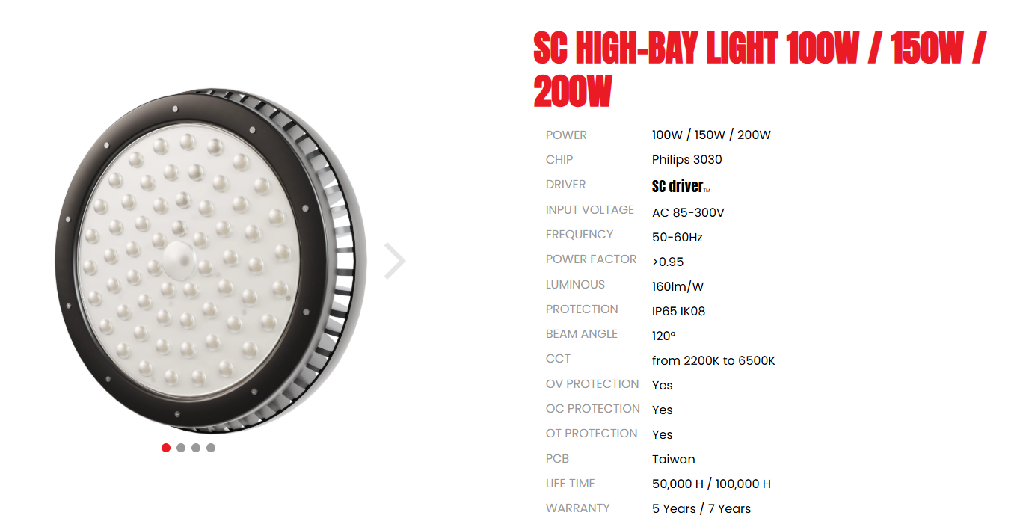
Choosing Right Values
Practical Scenarios :-
Office: 4000K , CRI > 80
Studio: 5000K+ , CRI > 95
Retail: 3000–4000K , CRI > 90

Slide 11
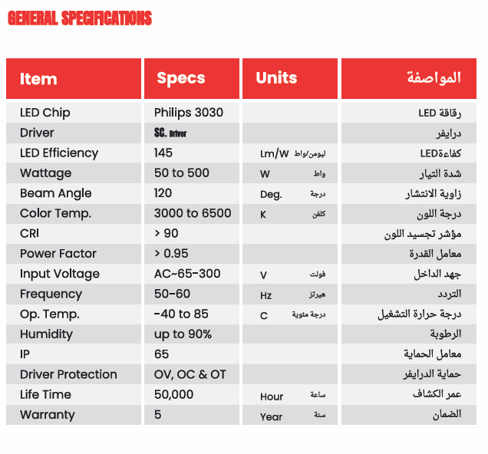
Choosing Right Values
Reading CCT & CRI in Datasheets :-
CCT listed in Kelvin
CRI may appear as Ra or CRI80/CRI90
Check both values before selection

Slide 12
What Affects CCT & CRI Output?
LED Type & Phosphor Mix
Most LEDs emit blue light converted to white using a phosphor layer.
The type of LED chip and the phosphor composition directly determine base CCT and CRI.
For high CRI, phosphors with enhanced red output are used.
Driver Current
Higher current can shift the output slightly (warmer/cooler), mainly affecting CCT.
Does not typically enhance CRI.
Optics & Lenses
Don't change spectrum but affect perception of color.
No impact on actual CRI.
Heat & Aging
Long-term use and heat can cause drift in both CCT and CRI.
CRI Target in Design
LEDs are engineered at manufacture to hit specific CRI values (e.g., CRI80, CRI90).
CRI can't be adjusted electronically or optically.

Slide 13
How to Adjust CCT and CRI
To change CCT:
Choosing the Right CRI
Change LED Type: Choose a different Kelvin-rated LED (e.g., 2700K vs 6500K)
Phosphor Composition: More yellow phosphor = warmer CCT
Optics/Filters: Can influence perception but not actual CCT
Use Higher Quality LEDs: Better spectral coverage
Phosphor Quality: Specialized phosphors enhance color fidelity
Cannot be adjusted electronically or optically must change the LED

Slide 14
Summary
CCT: Controls mood, ambiance
CRI: Ensures accurate color reproduction
Choosing the right light = Balanced CCT + CRI

Slide 15

Thank You / Questions?

